Slide 1
Stock Predictions Using Machine Learning & Python
Xuan He
Alex Koynoff
Prathyusha Challa
Zelalem Kebede
Itunu Oyeyipo

Slide 2
Project Overview
Use Machine Learning to predict stock prices
ML models selected:
scikit-learn(sklearn) - Linear Regression
scikit-learn(sklearn) - Support Vector Regression (SVR)
Picked 10 random stocks and loaded 12 months of historical prices
Predicted 30 trading days and compared to the real prices
Simulations for each model ran over 200 times. Took the average of all simulations for the visualization
Tools used:
Review and visualize the results
Summary and commentary
Excel Pandas | Matplotlib Tableau

Slide 3
Machine Learning Models Used
Sklearn - Linear Regression (LR) (from sklearn.linear_model import LinearRegression)
Overview
Searching for a relationship among variables
Dependent variables (y) or responses
Independent variables (x) or predictors
Pros
One of the most widely used as it is easier to interpret the results
Works on any size of dataset
Gives information about relevance features
Cons
Conversely, it assumes there is a straight-line relationship between dependent and independent variables which is sometimes incorrect
It can be very sensitive to outliers or anomalies
The algorithm assumes data is normally distributed in real when they are not.
It is not recommended for most practical applications because it oversimplifies real world problems.

Slide 4
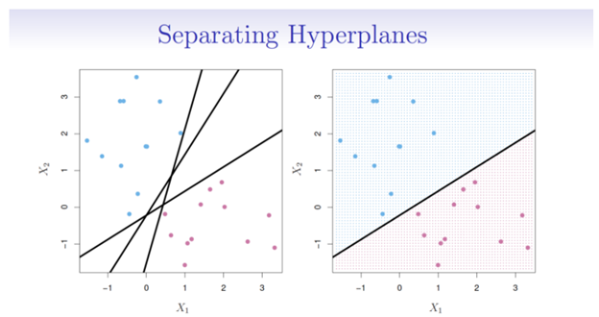
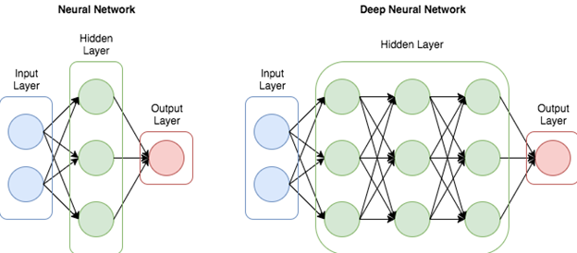
Machine Learning Models Used
Sklearn - Support Vector Machine (from sklearn.svm import SVR)
Overview
A linear model for classification and regression problems
SVM algorithm for pattern recognition
The algorithm creates a line or hyperplane which separates the data into classes
The basic idea of SVM:
Just like 1-layer or multi-layer neural nets

Slide 5
Machine Learning Models Used
Sklearn - Support Vector Machine (from sklearn.svm import SVR) cont:
Pros
Works well on smaller cleaner datasets
It can be more efficient because it uses a subset of training points
Helps analyse data and identify trends.
Compute the multiplication of independent variables
Require less training when dealing with smaller datasets
No distribution requirements
Cons
Isn’t suited to larger datasets as the training time with SVMs can be high
Less effective on noisier datasets with overlapping classes
Can be inefficient to train, memory intensive and annoying to run and tune

Slide 6
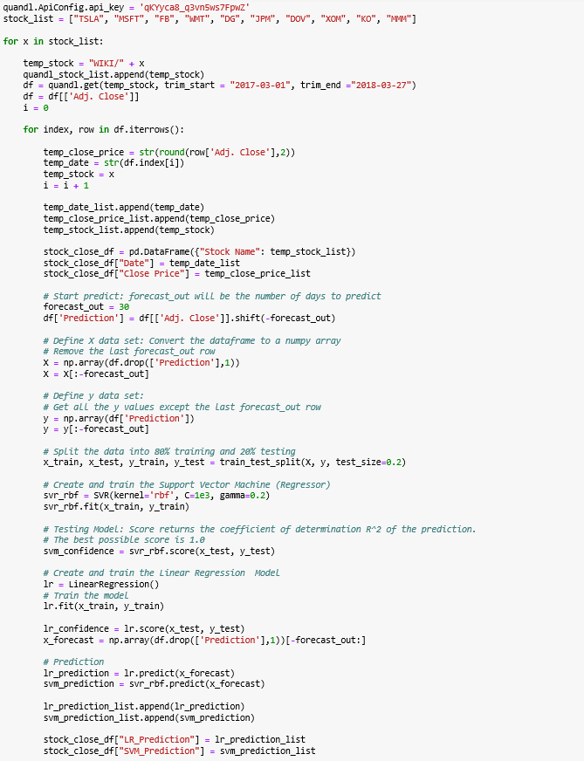
Code
Selected 10 random stocks
Ran 12 months of closing prices from Quandl API
Looped through the list of stocks
Selected 30 days of prediction
Each model included within the loop
Linear
SVR (Support Vector Regression)
Information put into lists and exported to csv for further manipulation and Tableau visuals.

Slide 7
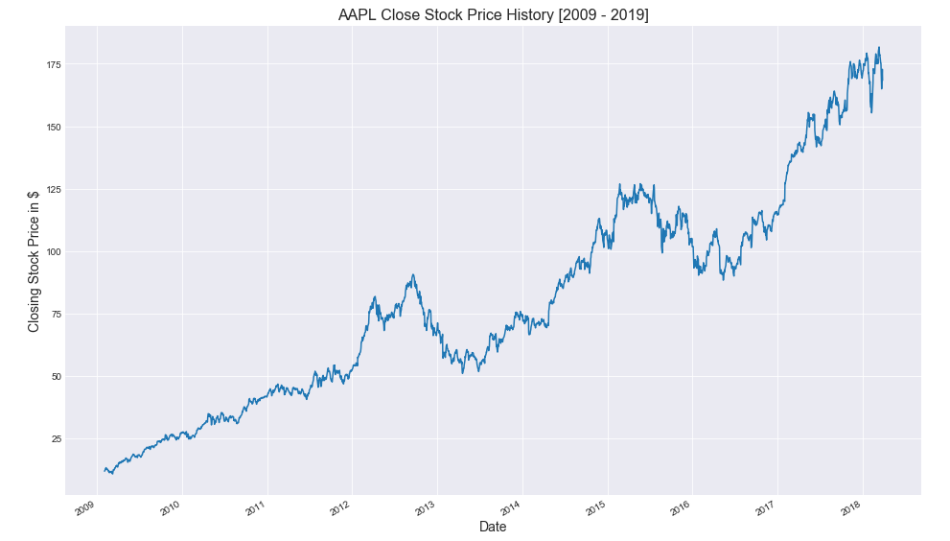
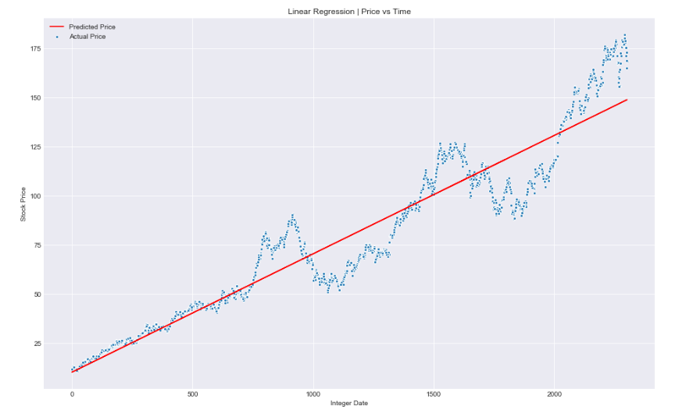

Slide 8
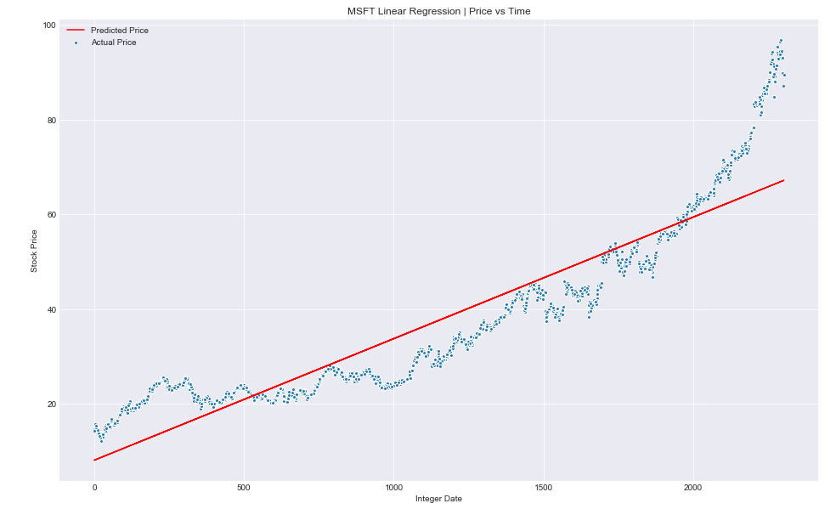
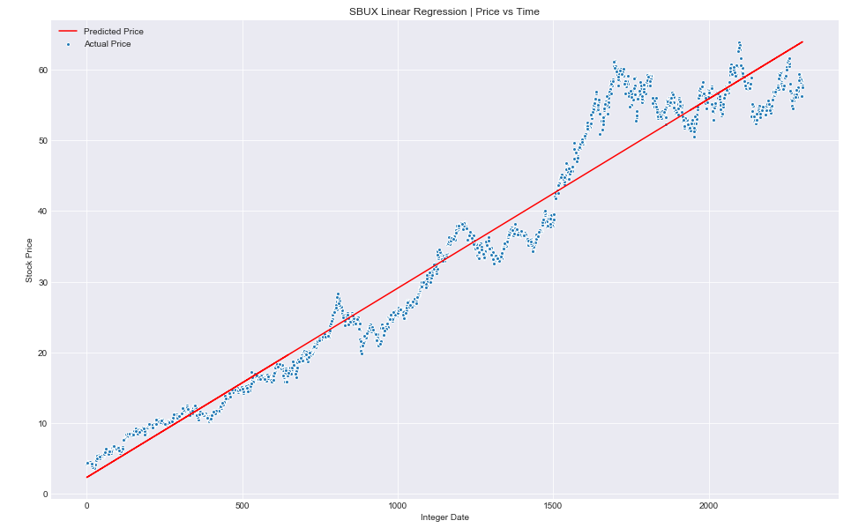
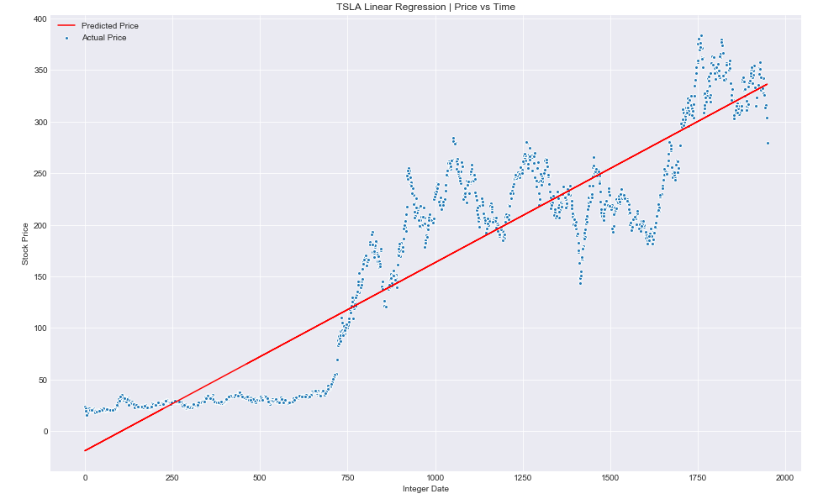
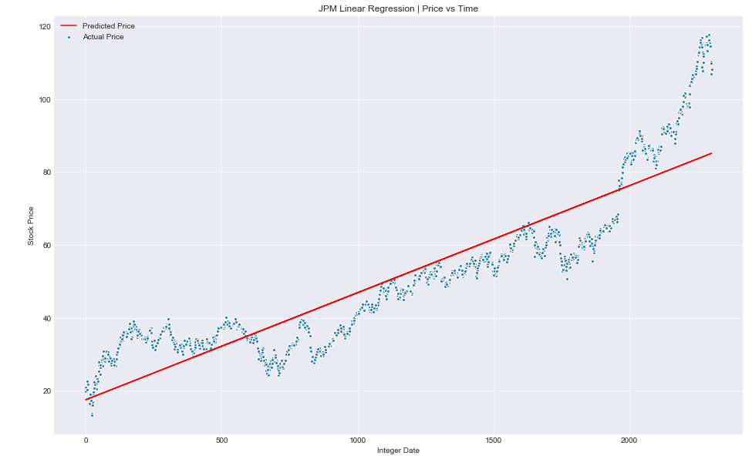

Slide 9
Visualization
CLICK ME!!!

Slide 10
Limitations and Future Considerations
Limitations:
Only one variable used (historical closing prices)
Probably neither Linear Regression or SVR is a good enough model to predict stock prices
Future Considerations:
Add other factors that impact stock prices to be built into the model
News
Industry specific trends
Company specific information
Fundamental analysis
Company financials, ratios, etc
Technical analysis
Moving averages, price patterns, charting techniques, etc
Build and test with other models and compare results
Deep Learning - Long Short Term Memory Network (LSTM)

Slide 11
Summary
Do not depend on our model to trade stocks! You will lose money!
Do not totally trust any prediction online! Make your own decision!
Add more variables for consideration in models to make them more accurate
Use different models and compare results
Use at your own risk!

Slide 12



Q & A
(or we can take a look at what ML can do and see few top trending stocks suggested by ML)

Slide 13
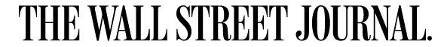
What Machine Learning Can and Cannot Do ?
Learning a function that maps well-defined inputs to well-defined outputs
Large (digital) data sets exist or can be created containing input-output pairs
No long chains of logic or reasoning that depend on diverse background knowledge or common sense
The task provides clear feedback with clearly definable goals and metrics
No need for detailed explanation of how the decision was made
A tolerance for error and no need for provably correct or optimal solutions
The phenomenon or function being learned should not change rapidly over time
Notes:
Data, Algorithms,

Slide 14

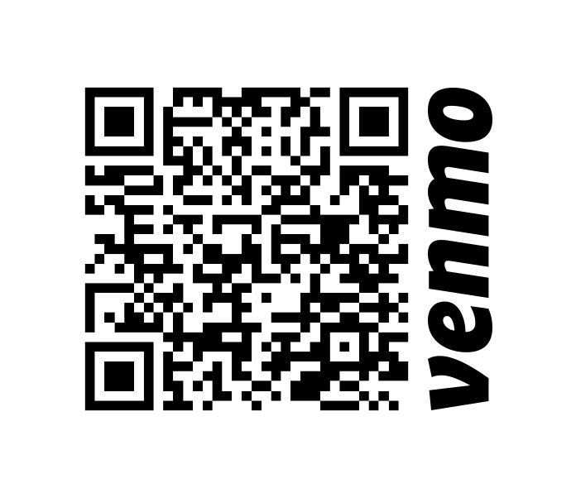
Five of the Best Stocks to buy based on US News
Advanced Micro Devices (AMD)
Chipotle Mexican Grill (CMG)
Nike (NKE)
Canopy Growth Corp. (CGC)
Microsoft Corp. (MSFT)
** Disclaimer : If you happen to make money buying the suggested stocks, Venmo here ⇒

